Slide 1

HYDROTHONE PROJECT
SEWAGE-MIXED DRINKING WATER __north madras (chennai)

Slide 2

PROBLEM
Sewage water getting mixed with the potable drinking water has become a common concern in parts of North Chennai, making public susceptible to waterborne infections. The situation has put many residents in a tough spot, as they are now buying can water for drinking and other purposes. In a compromised situation, people belonging to lower economic groups are using the water, as they cannot afford to buy can water.During an inspection conducted by Thiru Vi Ka Nagar MLA, P Thayagam Kavi on Friday, locals put forth their water grievances and requested the legislator to prevent water contamination. "The stench filled black water cannot be used for household purposes. This is a regular scenario during summers when the pipelines go dry. We are now buying can water for washing, cooking and drinking," Shasath Begum, a resident of Masoodi Street of Thiru Vi Ka Nagar. Speaking to Deccan Chronicle, Thiru Vi Ka Nagar MLA, P Thayagam Kavi said, "Sewer blocks are being cleared now. However, we urge the metro water department to put a permanent check to the issue. We have also checked the hand pumps and learnt that they are dry"Close to 4 wards in the constituency covering Nehru Nagar, Pulianthope, and Sashtri Nagar are facing the problem during summers. The stagnant sewer gets mixed up, thus making the public prone to water borne infections. "When the stench hits you in the face, you don't feel like taking a bath. Unable to use the contaminated water, we are spending Rs 1000 extra for potable water," said S. Easwaran, a resident of Pulianthope. Spokesperson for Chennai Metro Water said that he had directed the area engineer to look into the issue.

Slide 3
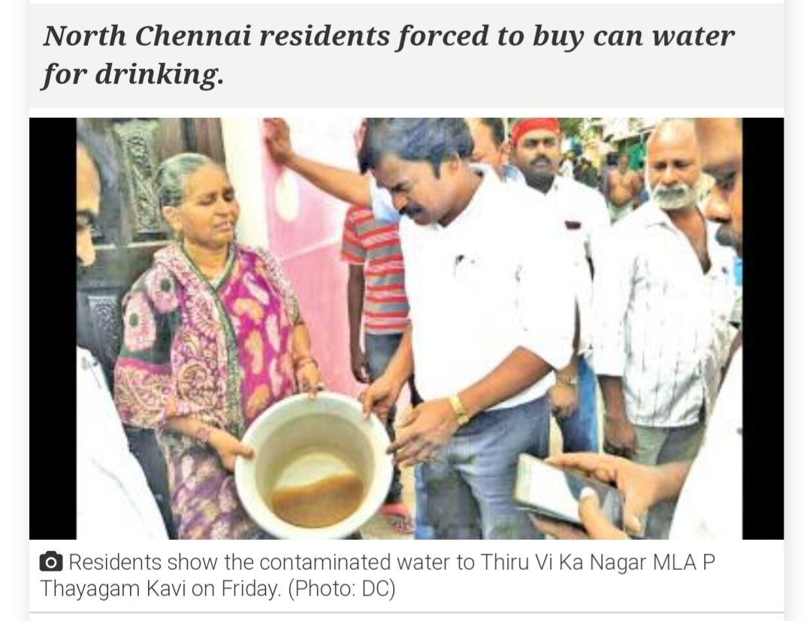
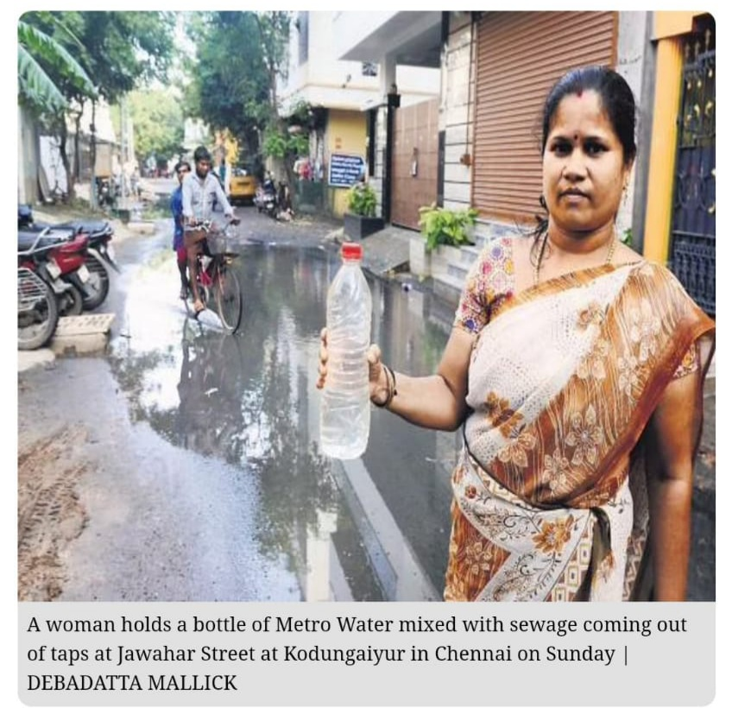

Slide 4
SOLUTION
¹Detecting flaws in pipeline by using Sensor and micro robots
²water treatment

Slide 5
Sensor
We can use sound waves(ultrasonic waves) to scan the pipeline flaws
We can use mousture sensor to know water evel and mouster underground or in soil
We can also use ph value as to sence or detect drinking water and sewage water

Slide 6
Construction of Microrobot
In Microrobot we fix ultrasonic sensor to detect the flaws
LiDAR is to sence the position of the robot
And light sensor is to control the robot
Ph meter to determine the water quality in the pipline
And micro controller which we fix with programming
And it move with hydropower amd scan the pipe and give Immediate informatio to higher authority so the fix the problem in short time without any problem

Slide 7
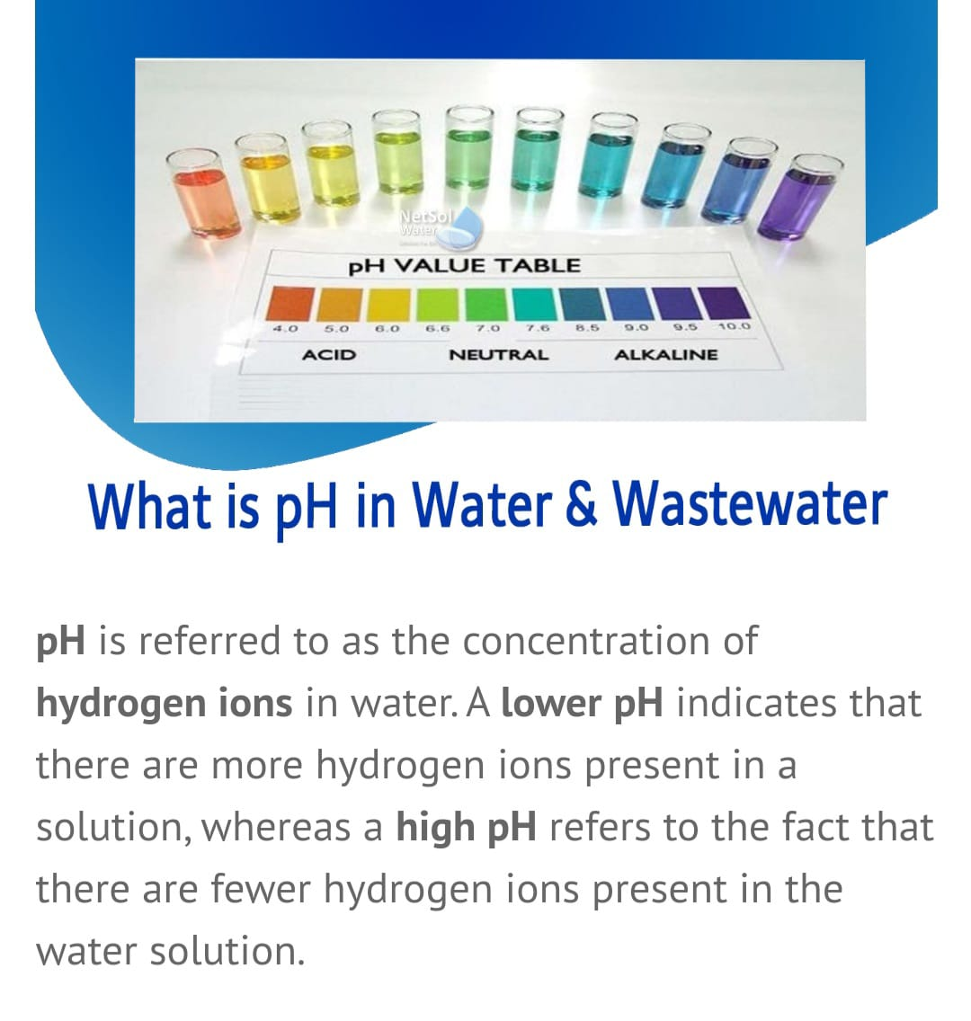
Ph scale….
To detect the water if it can be used as for house hold purpose or not we can use ph value
Ph value of drinking water is 6.5 to 8.5 and
Ph value of dirty water is above 8.5

Slide 8
Water treatment
By taking all the dirty water inside a big tank and mixing some chemical in it and after some treatment water can be reused as household purpose

Slide 9
Water treatment process
Primary treatment
At this stage, treatment involves removing solid particles from the sewage water. This stage focuses on removing large particles from the liquid solution.
Secondary Treatment
At this stage, treatment gets much more severe and critical. This stage focuses on removing all the organic waste from the sewage water.
Tertiary Treatment (Effluent Polishing)
At this stage, the water is quite clean. Still, there are some micro contaminants within the water. And these contaminants are generally toxic and hazardous.
So, this stage functions to remove these micro materials from the water. And this gets done through UV-based purification and clinical treatment. There’s also a sand filtration system to purify water at this stage.
So, after this stage, the water becomes completely clean and safe for drinking.
https://youtube.com/watch?v=s8IVjQg7yno&feature=share

Slide 10
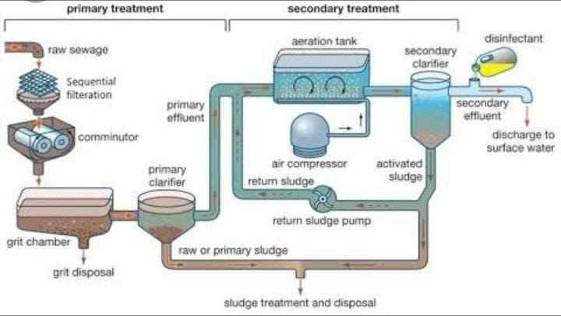

Slide 11
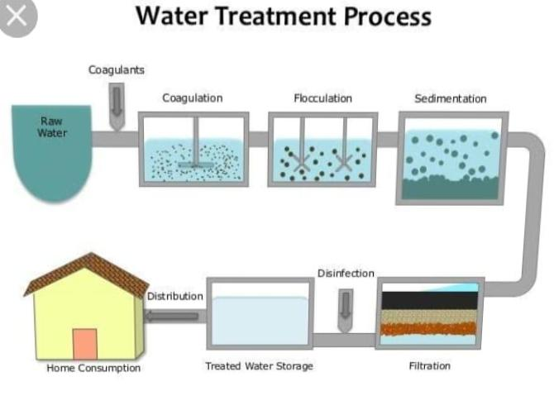

Slide 12
PROCESS HOW WE DONE THIS PROJECT
1st-we sence defaults by using sensors then
We replace damaged pipes into new pipes. Maybe because of heat and pressure pipe will broke so, we replace all the pipes slowly and put MICROROBOTS to sence the upcoming defaults and also at first to sence the defaults of pipes.
And at the same time we collect all the dirty water in a tank and through connecting different pipeline at same time and clean it with water treatment process.
Hence the water is saved from wasting.

Slide 13
DONE BY
BE.pharma 1st year
MD. AFZAL ALAM
Bio medical engineering 1st year
KASHISH FATIMA
Computer science engineering-cybersecurity 1st year
HARSHATH PARVES Z

