Slide 1
Innovative solutions to conserve water
- Sreyavarshini k
ethiraj college for women

Slide 2
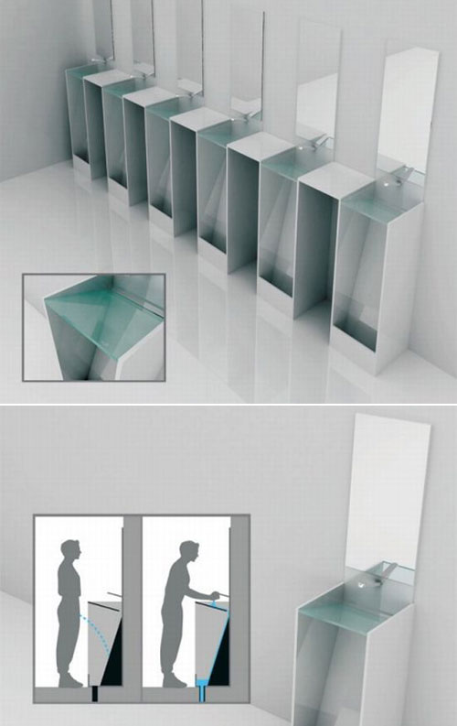
Urinal and Sink Combo
Eco Urinal is designed to use the water that was used for washing hands to flush the urine. By this process, we don’t have to use water twice after using the urinal. Moreover, it reduces the establishment expenses by optimizing the materials. Upper space of this urinal is made with glass, and it helps to secure a clear view for users. It also promotes people to keep their sanitation because people need to wash their hands to flush the urine after use.

Slide 3
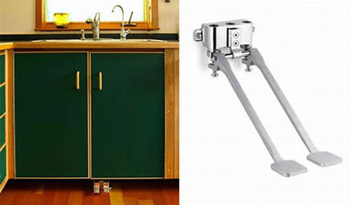
Foot Pedal Faucet Controller
The Foot Pedal Faucet controller allows you to control a faucet hands-free. The devices are efficient and promise to reduce water consumption by as much as 50 percent. The design makes it easy to save water when you’re brushing your teeth of doing the dishes.

Slide 4
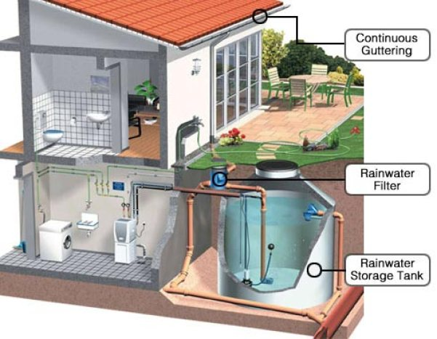
RAINWATER HARVESTING METHOD
The RAINWATER HARVESTING METHOD has provided a solution that can be practiced easily in every household. It is a simple model where the roof acting as a catchment for rainfall, which after flowing through a series of filters and pipes is stored in ground-level containers for direct use or recharged into ground water.

Slide 5
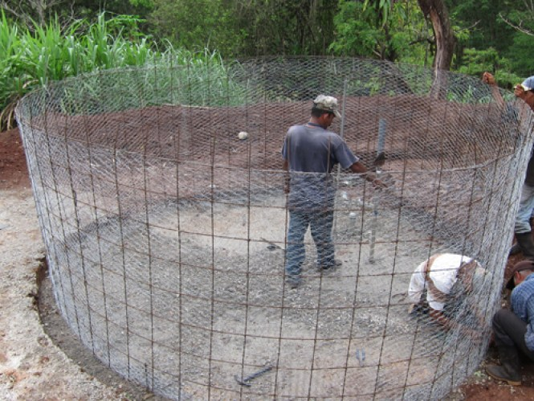
Ferro-cement Tanks
This is a low cost alternative for expensive water harvesting containers made of masonry, plastic and RCC. It has proved highly effective in high rainfall regions where large amount of water need to stored in clean form.

Slide 6
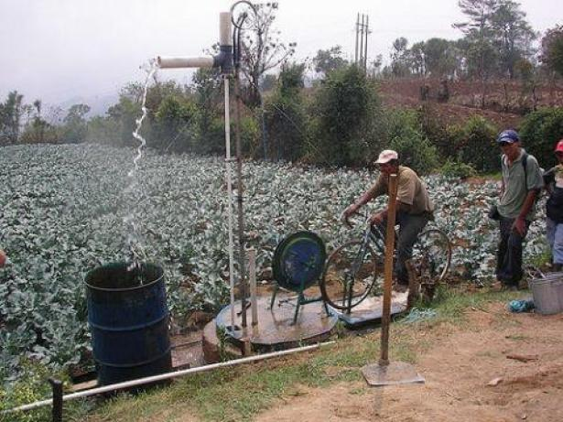
Cycle Run Water Pumps
This technology utilizes human power generated by pedalling a bicycle to lift water from streams, ponds, canals and wells. When cycle is pedalled, it creates an up and down motion of pistons which pressurizes water flow to outlet. A portable model which can be installed on site has also been developed. Designed for small scale farmers who don’t have capacity to afford costly diesel run motors

