Slide 1
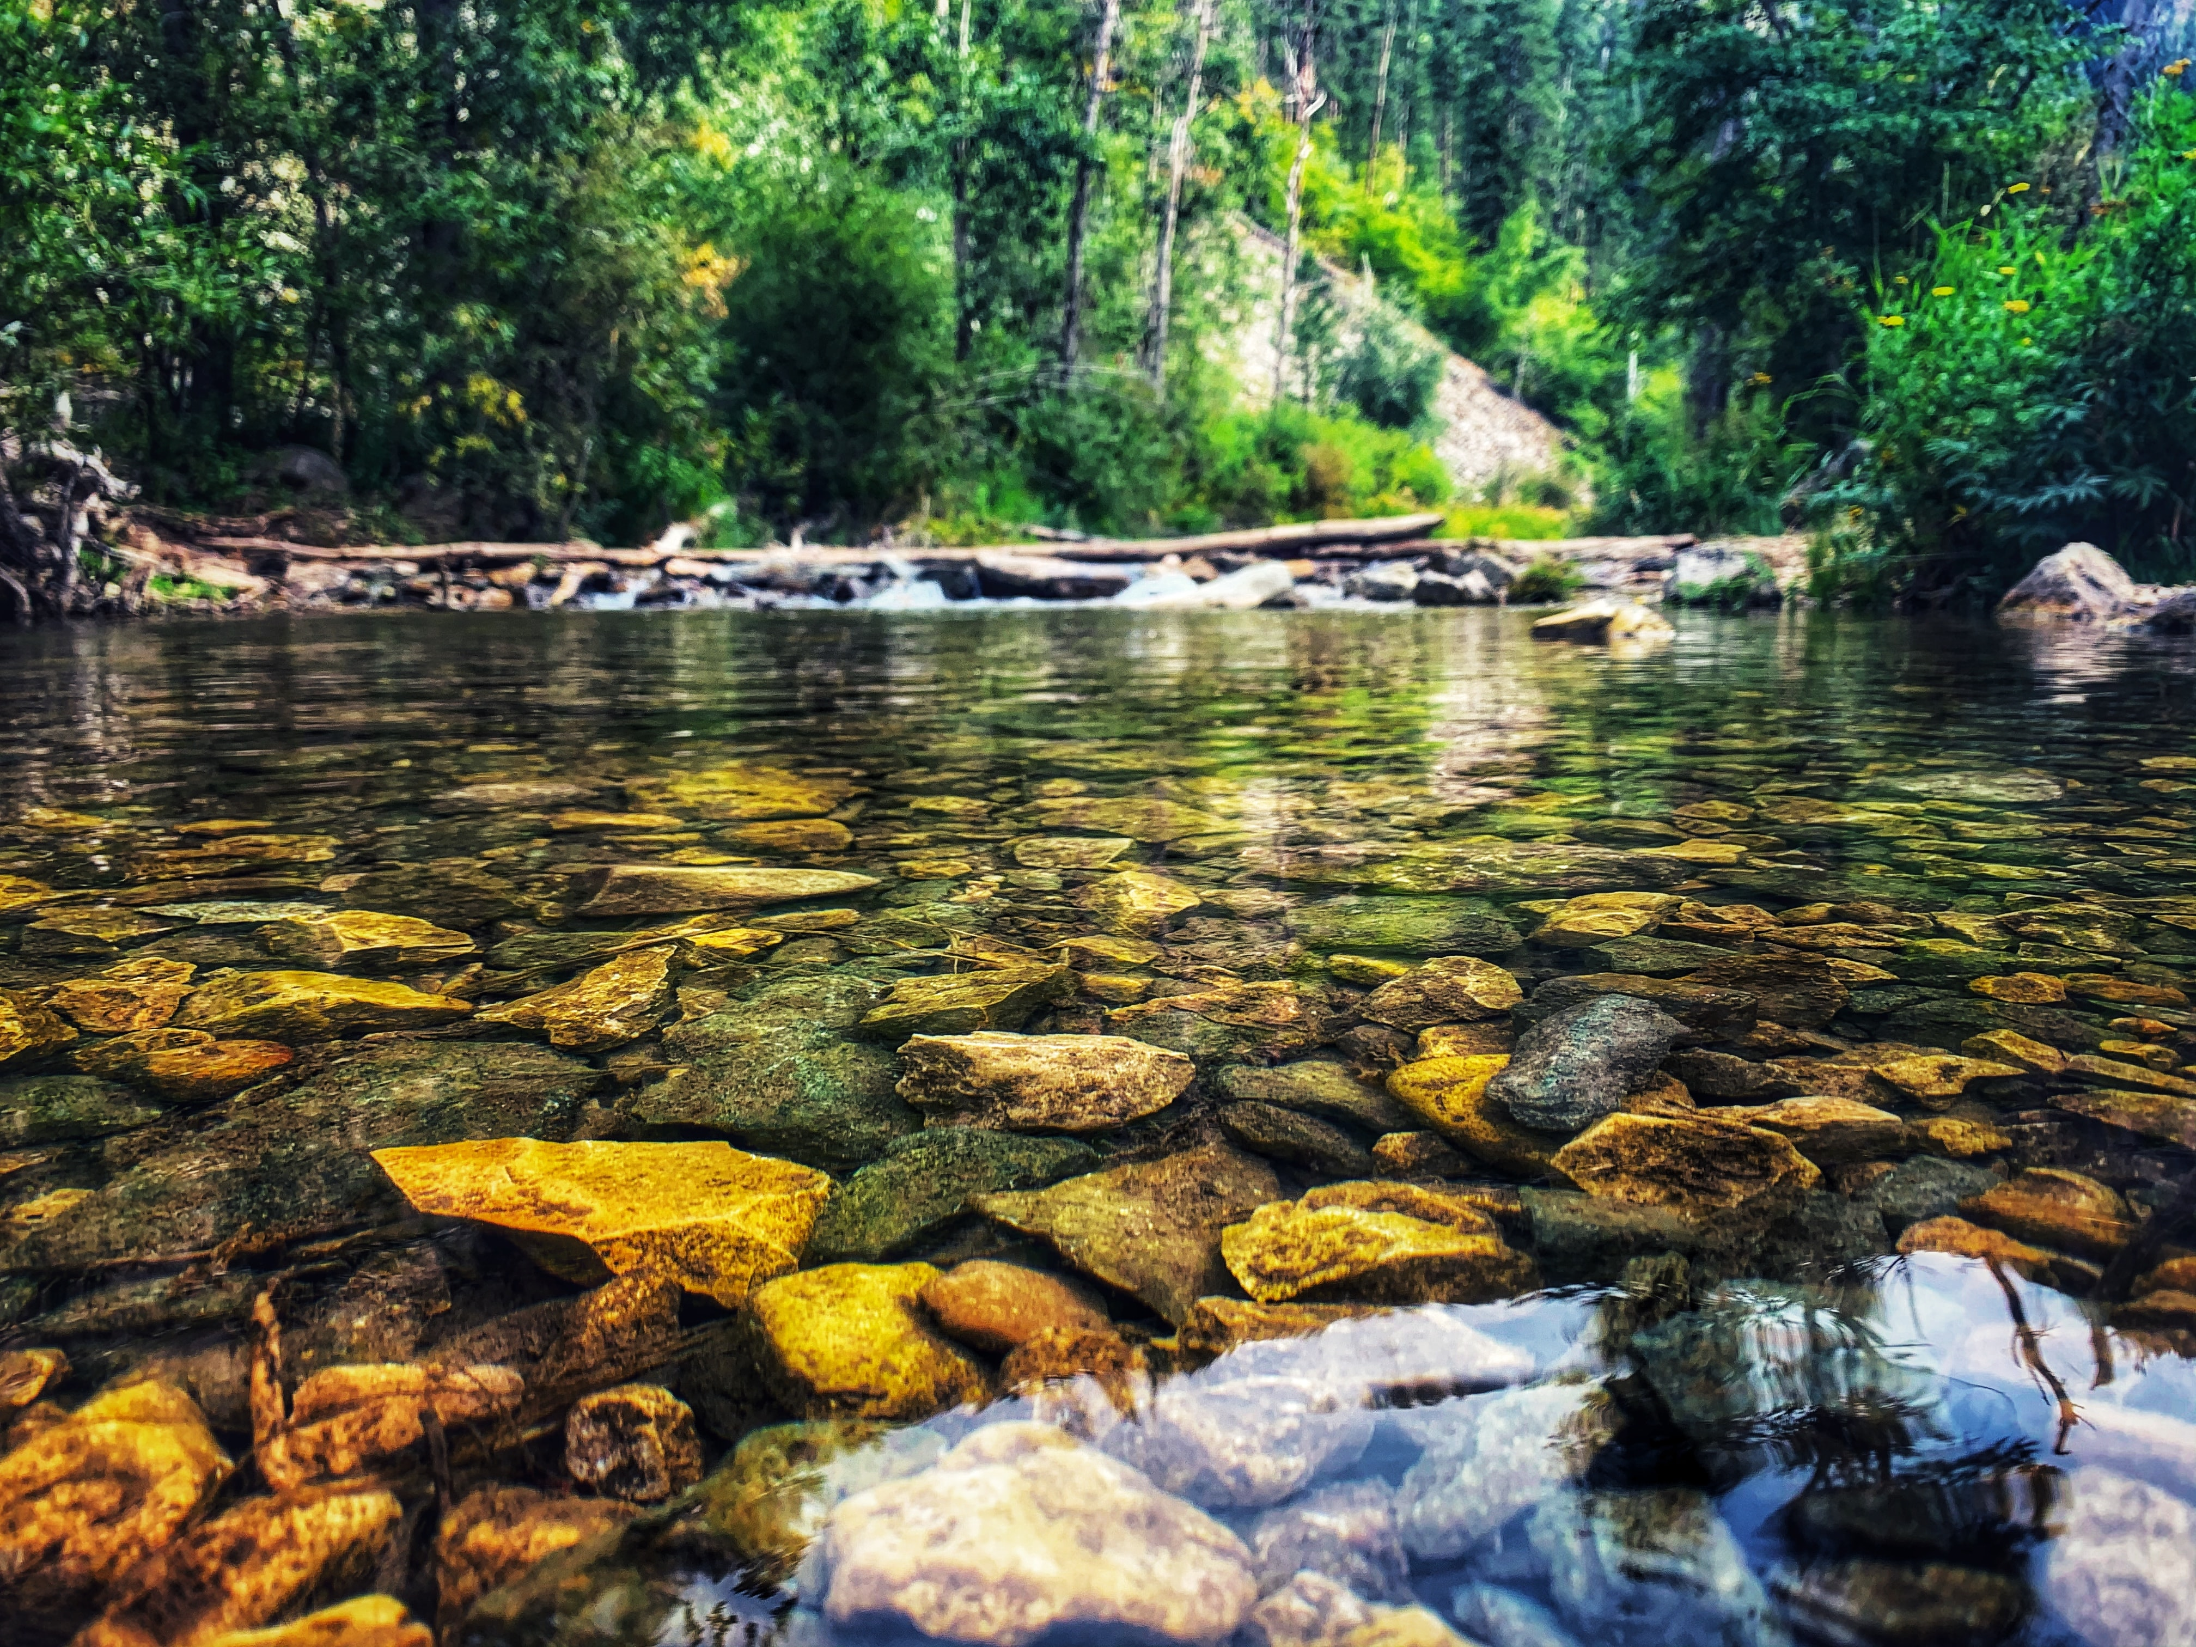
HELP YOUR CITY PRESERVE WATER BODIES
Tanni
App

Slide 2
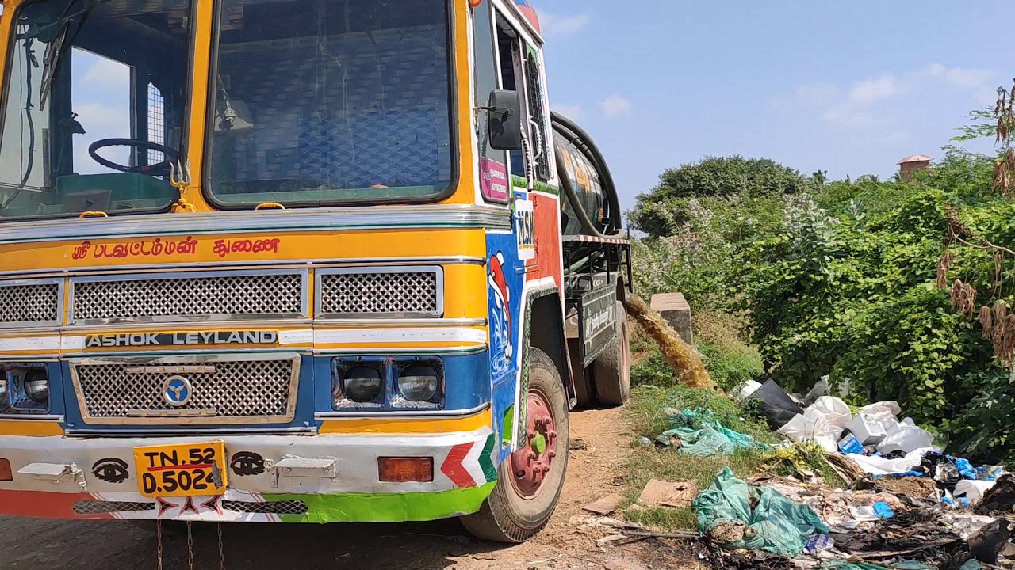
Chennai water
bodies contamination
High sewage contamination of Chennai waterbodies.
Water reservoirs are not safeguarded from public access
Coliform bacterias contaminate groundwater harming animals and humans

Slide 3
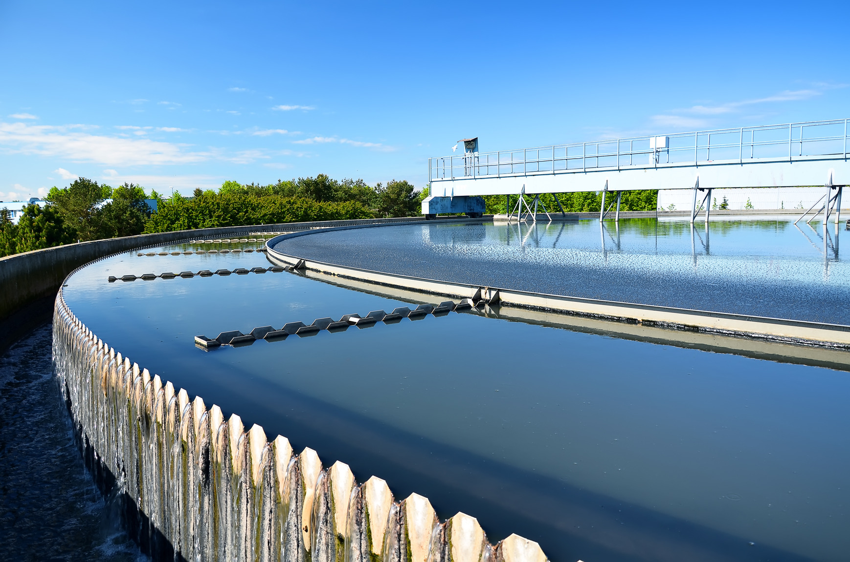
SOLUTION
Make Sewage tanker’s service transparent
Connect house owners and Metro water
Close public access of water reservoirs

Slide 4
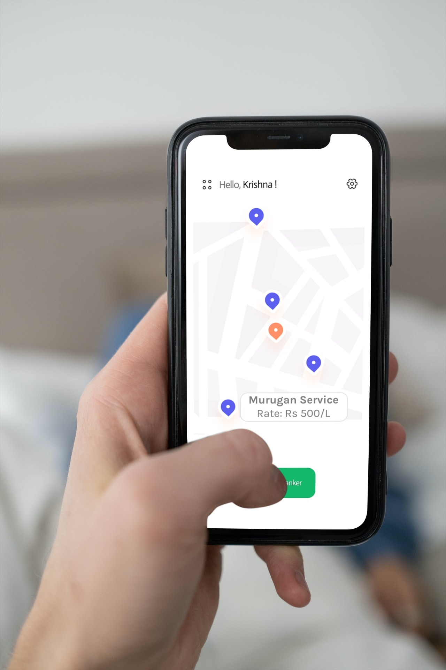
HOW WE HELP OUR CITY
TANNI application protects water bodies of our city
House owners participate directly in Sewage treatment
Easy and fast search of tankers by location and rate
Tankers get paid only after Metro water approval
Tanni
It’s in your power to safeguard Chennai water bodies

Slide 5

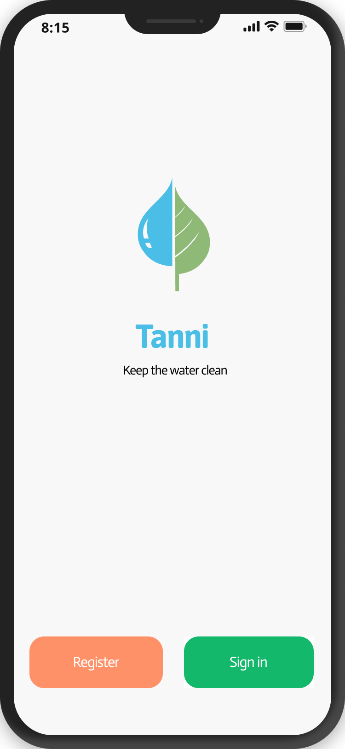
Tanni
app

